Slide 1

A one stop solution for all your
daily needs
Jumbo Cart

Slide 2
About Team- Batch(94)
Manasvi Runwal - 6467
Divya Macharla - 6463
Kunal Sundaram - 6466
MD Ayaz - 6511
Shrenik Badjate - 6487

Slide 3
Softwares associated with the project
Visual Studio 2019 Community
MS SQl Server Management Studio

Slide 4
Technologies Used
C#
ADO.net entity framework
ASP.net MVC
Boot Strap

Slide 5
Objectives
To enable easy access to the daily needs of the public
User Friendly UI
Standard Response Time Managed

Slide 6
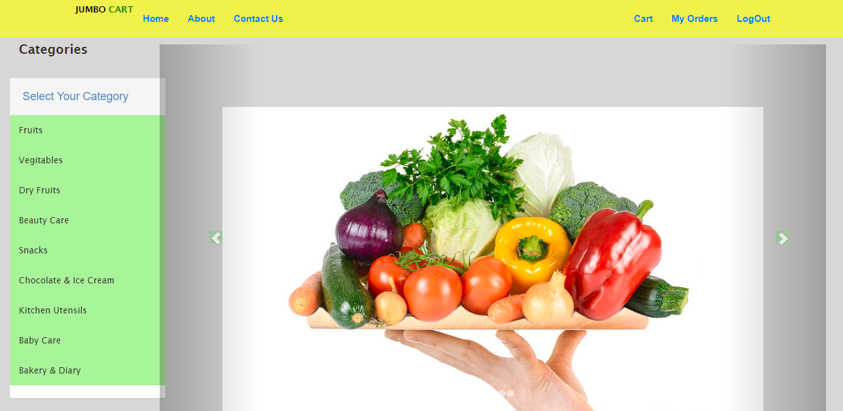
HOME PAGE

Slide 7
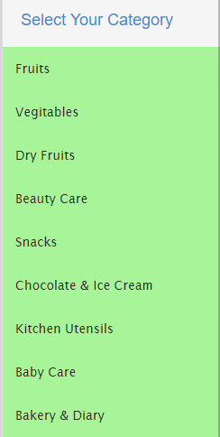
Categories

Slide 8
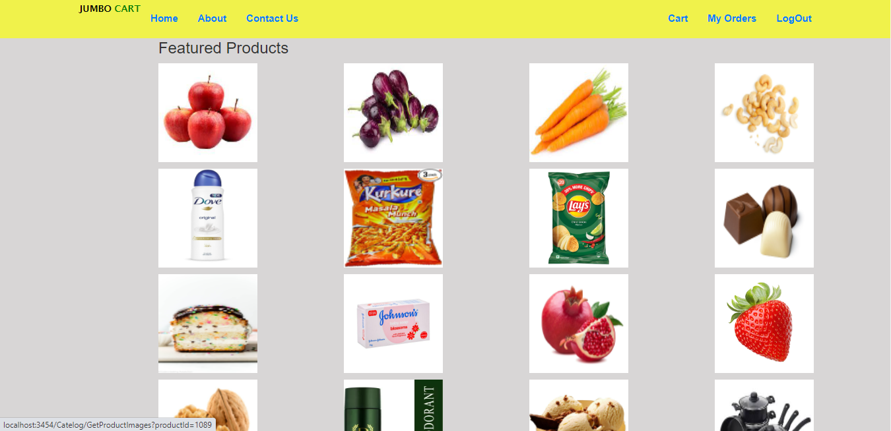
Featured Products

Slide 9
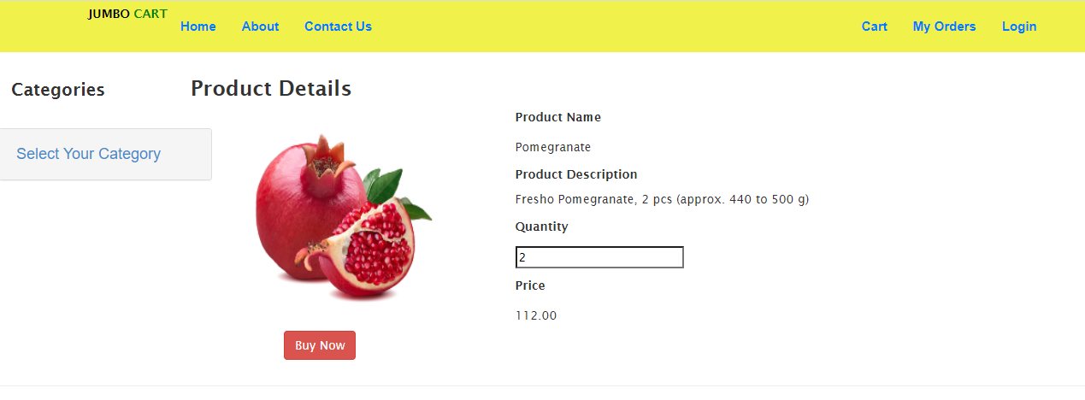
Product Details

Slide 10
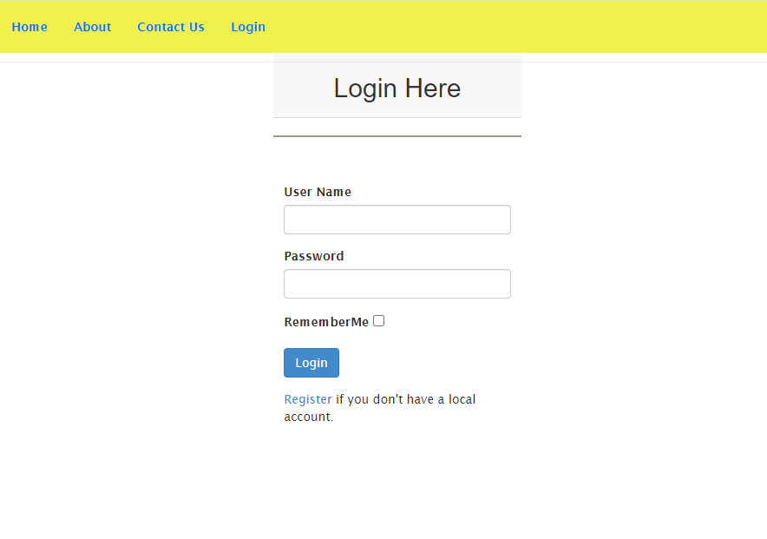
Login Page

Slide 11
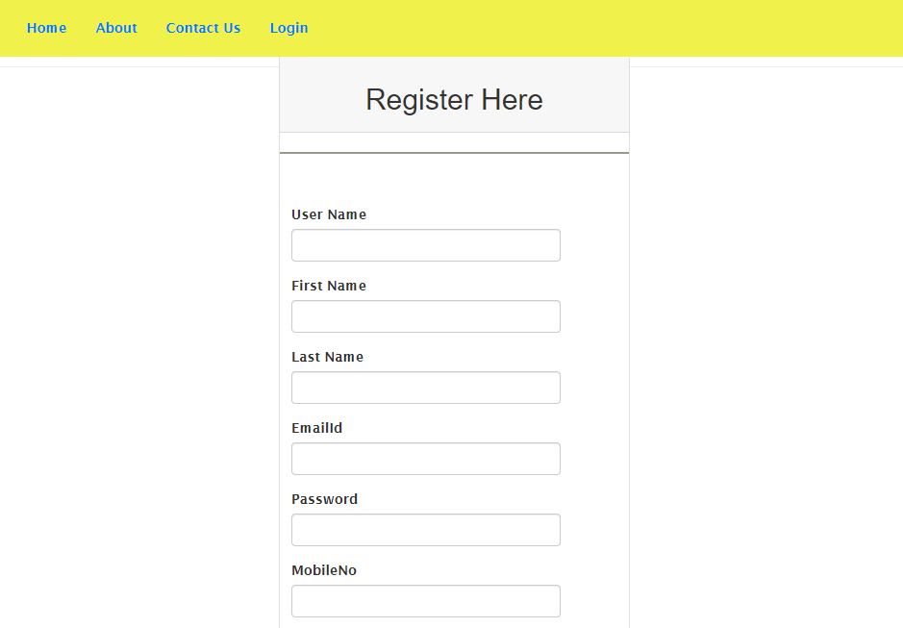
Register Page

Slide 12
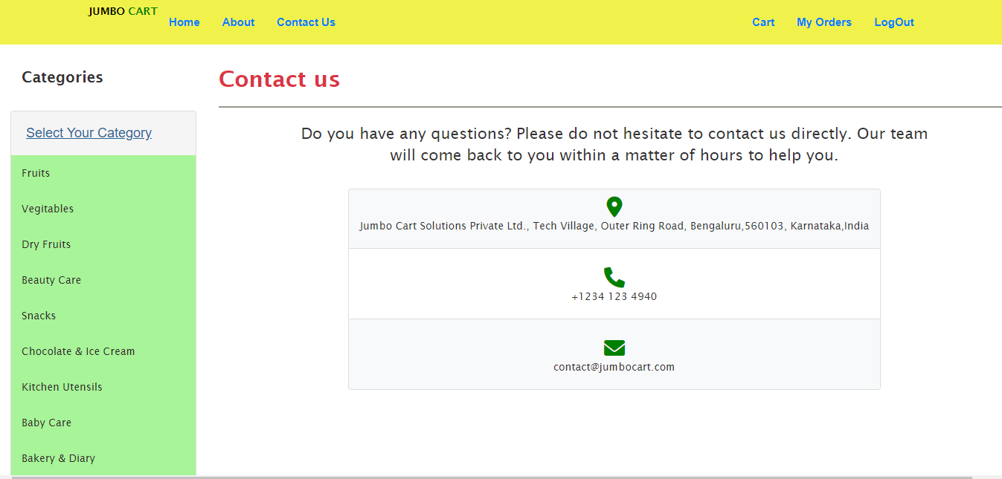
Contact us

Slide 13
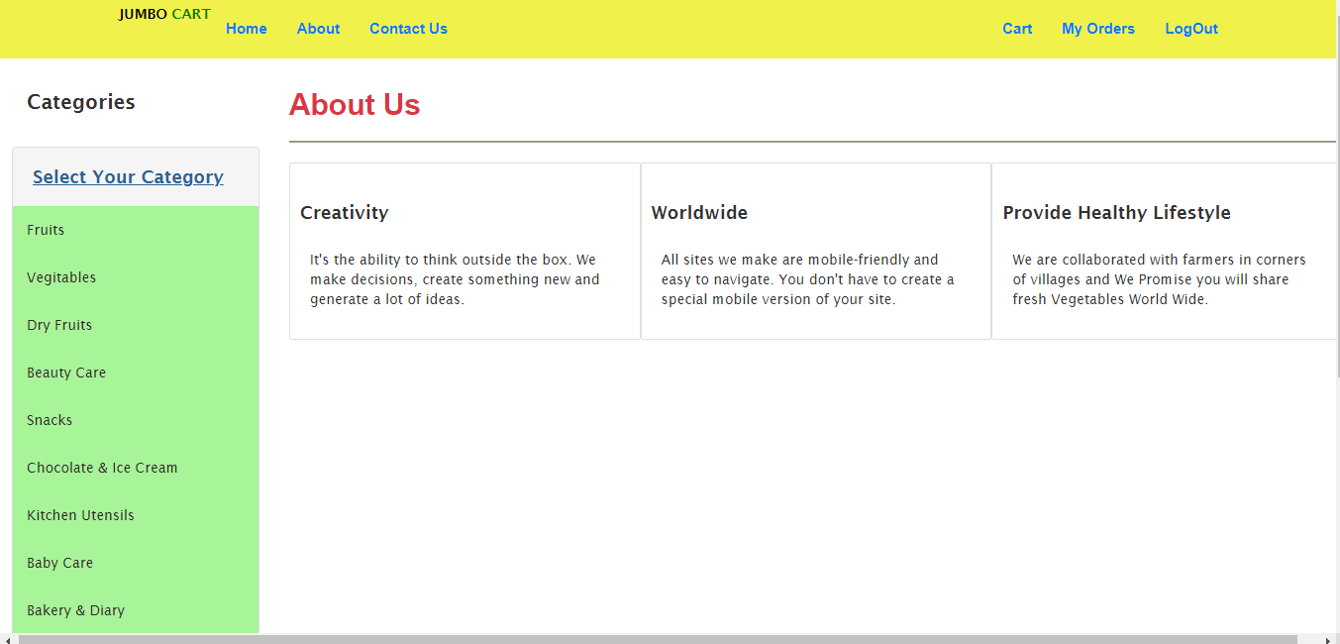
About Us

Slide 14
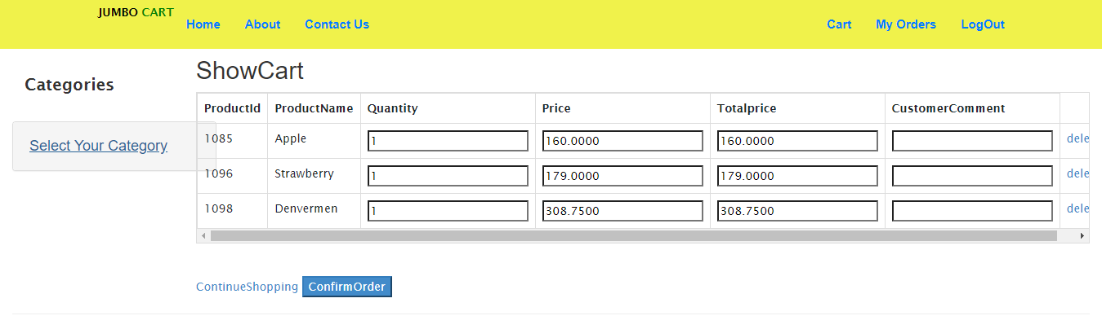
Cart

